Slide 1
An Introductory Nuclear Deterrence Wargame
DSTL/TR170295
Ethan Sykes

Slide 2
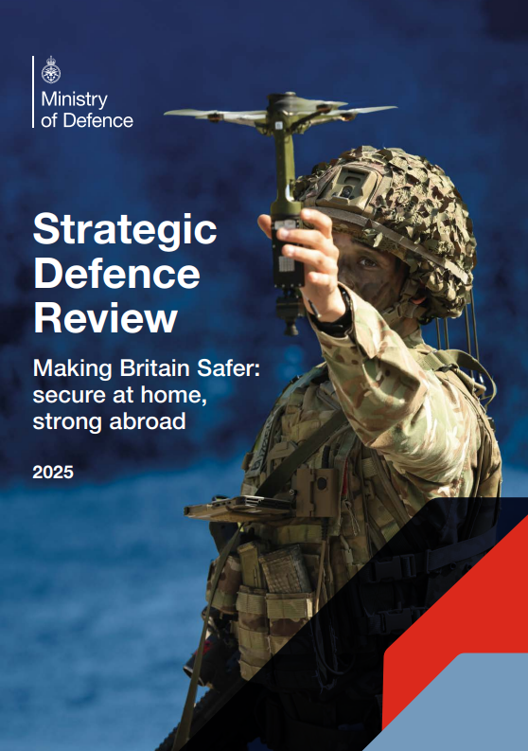
The challenge
The Strategic Defence Review sets out how delivering the UK’s deterrent is a national endeavour
This necessitates engagement with the public to convey the importance of the UK’s deterrence policy
In essence it requires raising the nuclear IQ

Slide 3
RUSI Project on Nuclear Issues (PONI)
PONI draws together a diverse community with a range of experiences from civil society and non-government backgrounds
PONI provides knowledge and skills development opportunities to its members
PONI offers a range of platforms for emerging nuclear specialists to expose their skills to broader audiences

Slide 4
What was the aim?
The aim of this collaboration event was to:
  Illustrate how nuclear deterrence can be represented in an accessible manner
  Demonstrate the challenges facing decision makers in a nuclear crisis
  Produce escalation pathways which could be analysed and compared to theories of escalation

Slide 5
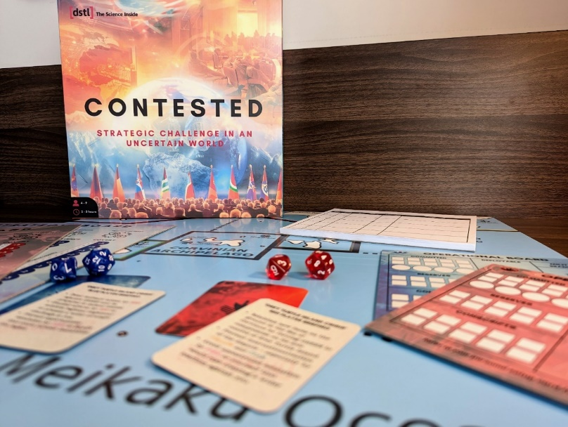
How did we do this?
We needed an experiential game with:
  A sufficiently simple ruleset to ensure focus and maintain accessibility
  Representation of nuclear deterrence
The Defence Science Technology Laboratory has a range of games which can be used to address similar questions
However many of these require significant expertise, or are ran in a classified environments
Attendees from across government, industry, academia, military, and think tanks
Contested was developed as a game that could be played by stakeholders without gaming experts present
  This required an accessible and simple game
  Contested has been delivered to: MOD, FCDO, Cabinet Office, GCHQ, and Kings College London
Contested fits the first requirement but not the second

Slide 6
Original Contested
Contested is a game based on conversation with dice rolls to determine outcomes
Players have a range of trackers which detail their relative capabilities
They also have a range of objectives and a list of actions
Players consider the board and plan their actions before negotiating
Players are asked to select a number of actions
These actions are then adjudicated with the help of a dice roll
Players then can battle with any adjacent units
Players can then move their units

Slide 7
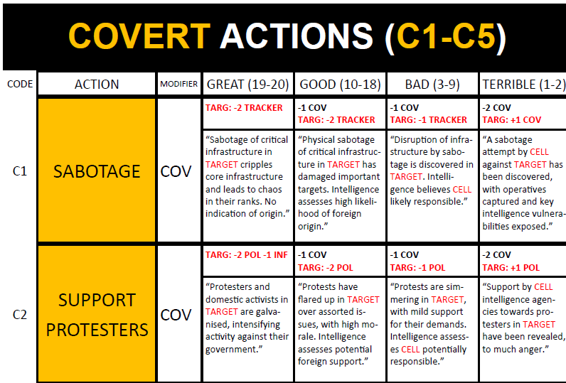
Original Contested

Slide 8
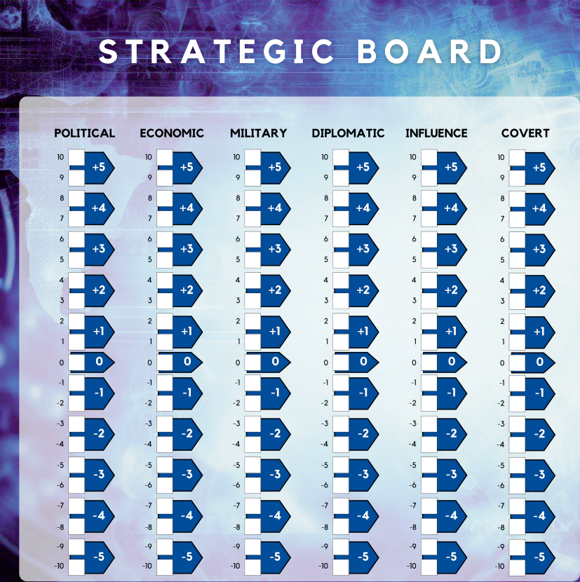
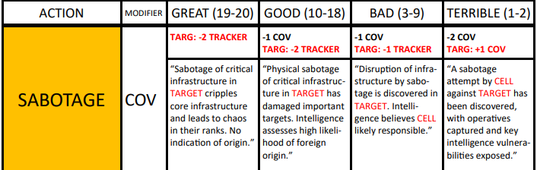
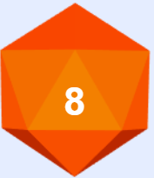
Example turn

Slide 9
Example turn
Notes:
This can look complicated but it only requires one facilitator and players swiftly learn to play to their strengths

Slide 10
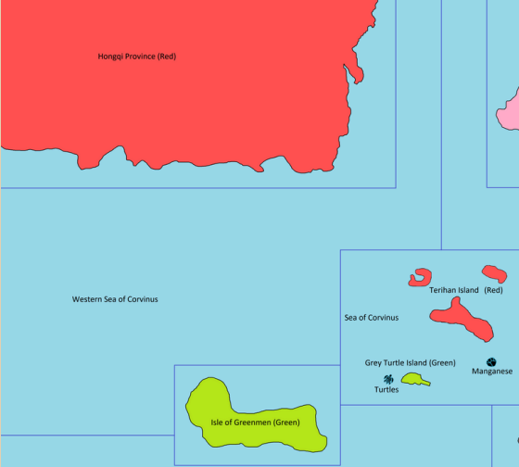
Scenario
Grey Turtle Island is a small uninhabited island midway between Green and Red and is claimed by both
Green seceded from Red approximately 70 years ago and has maintained de facto independence ever since
Red has never acknowledged this independence
Blue is an off map democratic great power committed to the defence of Green but not necessarily through direct military involvement
~50 of armed Red elements masquerading as environmental protestors land on Grey Turtle Island
Green enforces a naval blockade which Red breaks through
Green responds with kinetic strikes on Grey Turtle Island
Red demands the deportation of those involved
Red
Red
Grey Turtle Island
Green

Slide 11
Amendments
To include the nuclear amendments we made a number of changes
  Addition of nuclear capabilities
  Addition of new strategic actions
  Amending of the battle aspect of the game

Slide 12
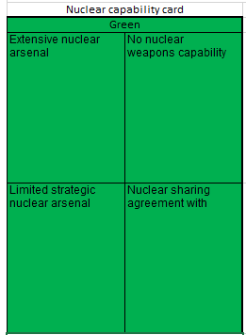
Amendments – nuclear capabilities
We ascribed a nuclear capability to each player
  Extensive nuclear arsenal
  Limited Strategic nuclear arsenal
  Nuclear sharing agreement – akin to Germany
  No nuclear weapons capability
Notes:
The first change that was necessary was to give each player an explicit nuclear capability

Slide 13
Amendments – nuclear actions
We also added a range of new actions that players could take depending on their nuclear capability
  Nuclear test detonation
  Demonstrative use
  Creation/ending of a nuclear sharing agreement
Players could also take number of signalling actions while negotiating
  They could assert their nuclear readiness state
  Players could assert their decision and willingness to protect an ally from nuclear attack
Notes:
Having made the previous change it was then necessary to add new actions players with nuclear capabilities could take

Slide 14
Amendments – sub-strategic nuclear use
Players also had to assert whether they were equipping their troops with protective CBRN gear
  Doing so protected against nuclear use, while impairing conventional effectiveness
During the battle phase, players could use sub-strategic weapons to try and attain a tactical advantage
Following this, players with strategic arsenals were asked if they wished to respond with strategic nuclear use which ended the game
Players could also use sub-strategic weapons outside of combat against a conventional target
Notes:
Finally it was necessary to account for the use of non-strategic nuclear weapons

Slide 15
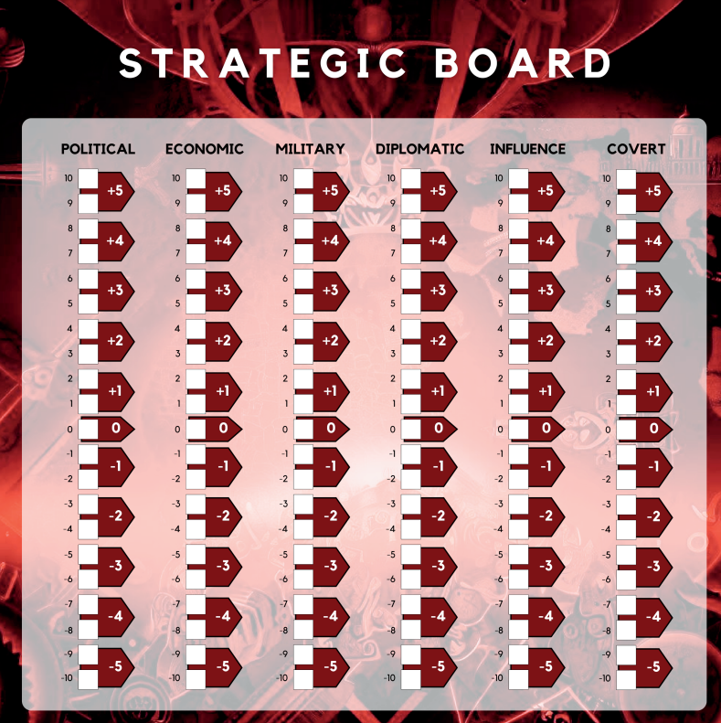
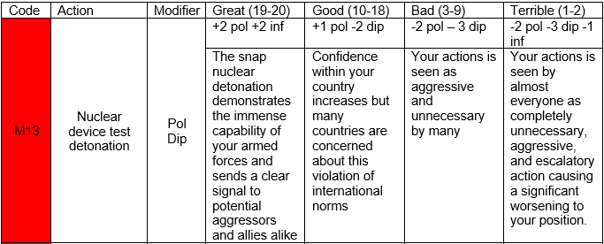
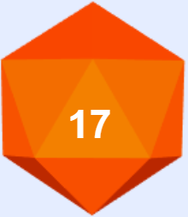
Example turn

Slide 16
Games 1 and 2
Summary of games
  Game 1
    The game steadily escalated and culminated with Red nuclear use to capture the contested island
    This was motivated by Red’s belief success could not otherwise be guaranteed
  Game 2
    Red focused on invading the island as quickly as possible, but avoided nuclear use as it was unnecessary
    Blue was equally unwilling to use nuclear weapons due to it being too costly to do so, and conventional means were deemed sufficient
Theory application
  In games 1 and 2 behaviour was akin to that described in Herman Kahn’s escalation ladder
    Herman Kahn postulated that actors have 44 graduated steps between peace and nuclear war
  This is because the Red player identified the level of escalation they needed to achieve their goal and acted accordingly

Slide 17
Summary of game 3
Summary of game 3
  Early in the game a test nuclear detonation was conducted
  Players then realised the threat of mutually undesirable escalation and resolved the crisis by peaceful dialogue
Application of theory
  Bargaining theory argues states seek to avoid conflict but benefit from easy victories where they can and avoid high costs of not acting
    For this reason they seek to demonstrate credible threats to each other's security
  Similarly, decision theory argues nuclear war is so costly no leader would ever contemplate it
    As a result, it argues international crises are a way of exhibiting and measuring power with states facing the challenge of convincing others they will not surrender if challenged
  The early nuclear test detonation in game 3 can be seen as both a demonstration of a credible capability, and a statement of determination

Slide 18
Evaluation
What does the variation in game play tell us:
  There is enough flexibility built into the game
  Different players can take different assumptions from the same context
  The dynamics of a player group matter
What do we plan to do next:
  Run more games and pass on this capability to RUSI
  Deliver more sophisticated games to a closed audience
  Continue investing in our classified games capability

Slide 19
© Crown copyright (2025), Dstl

Slide 20
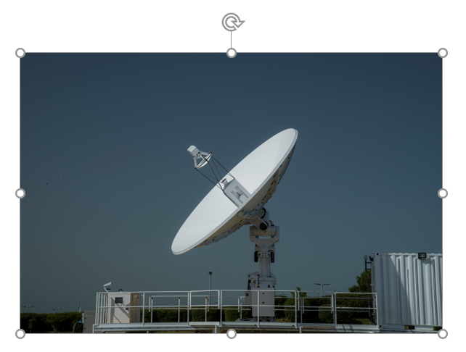
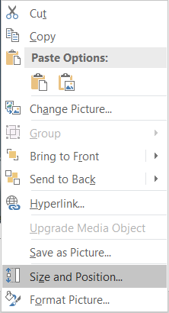
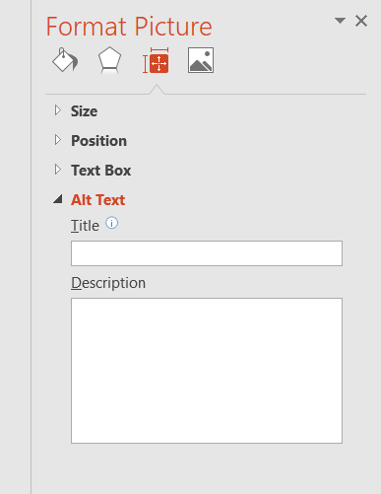
Instructions - Adding Alt Text to Images
Click on the picture
Right click to show the options menu
Choose Size and Position…
The Format Picture panel will appear to the right
Select the Size & Properties
In the Alt Text section, add an appropriate description
2
4
5
1
6
3
(Delete this page from your presentation)

Slide 21
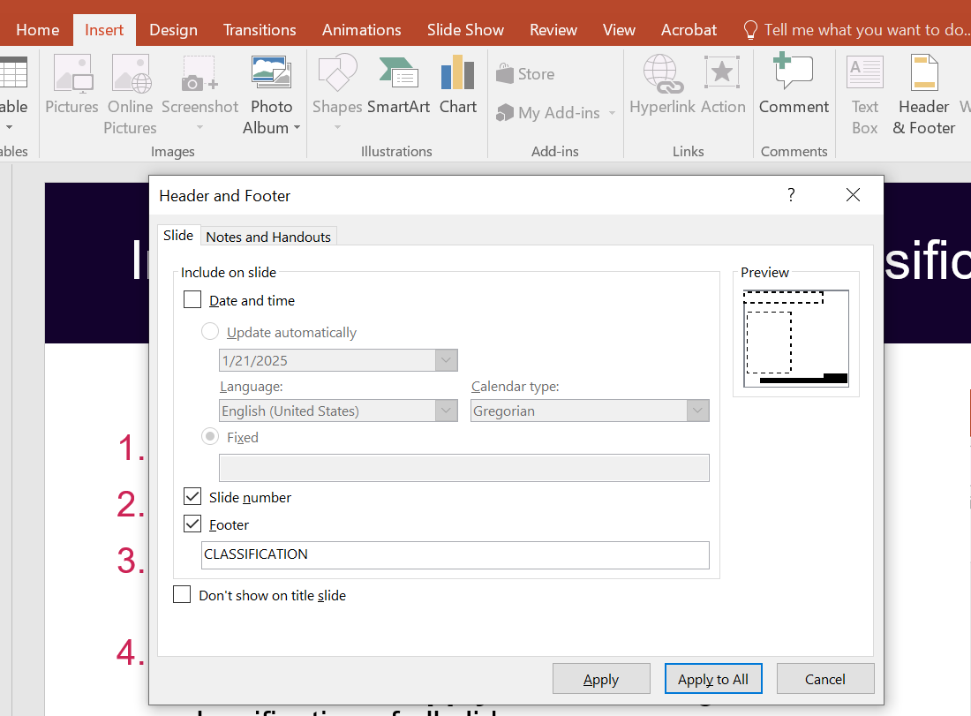
Instructions - Changing the classification of slides
1
Select the Insert tab from the Ribbon
Click Header & Footer
In the Footer, change CLASSIFICATION to the appropriate classification
Click Apply to change the classification of the current slide or Apply to All to change the classification of all slides
2
3
4
(Delete this page from your presentation)

Slide 22
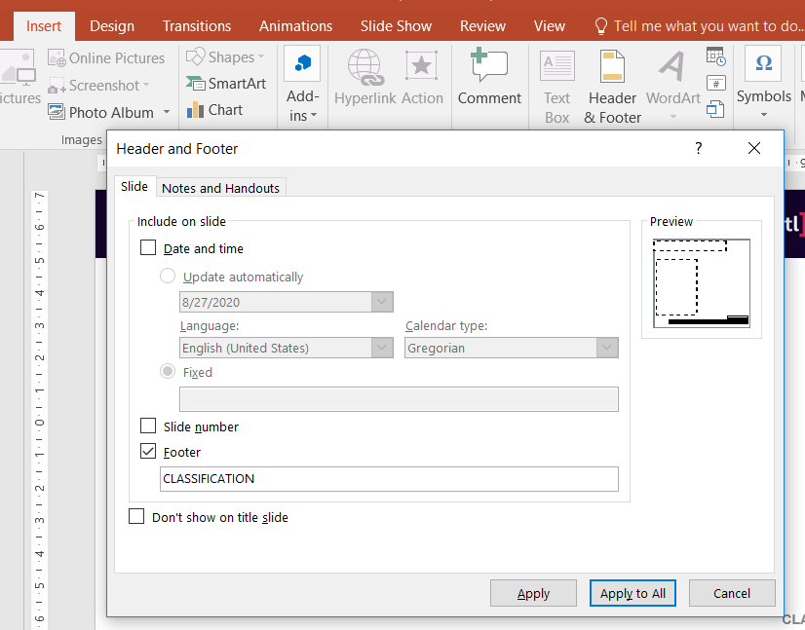
Instructions - Adding slide numbers
1
Select the Insert tab from the Ribbon
Click Header & Footer
Tick the box next to Slide number
Click Apply to add the slide number to the current slide or Apply to All to add the slide number to all slides
2
3
4
(Delete this page from your presentation)

